Slide 1

Pre-study program
You are (most likely) planning to participate in the business simulation Celemi EnterpriseTM. You will be a member of the management team of
one of the competing companies. Your challenge is to create long term stakeholder value in tough competition against at least three other companies.
The purpose of this Pre-study program is to let you be better prepared for the actual simulation. As a result you will not only be better equipped to make the right decisions, you will also need less time to get up to speed.
We will walk you through the basics, step by step: What is it about? How does it work? How do you win the battle for customers…?
You will find an overview of the content when you click “Next” below.
Next

Slide 2
A guided tour
About 15 minutes.
CONTENTS:
  1. In a nutshell
  What the simulation is all about. The key elements when competing for customers.
  2. Customer segments
  What the customers have in common and what makes them different.
  3. Customer behaviour
  What makes the customer choose one supplier before another?
  4. Running the simulation
  An overview of the decisions you will make each simulation year.
  5. Prepare for the real thing
  A few things to ponder before you meet your team to run the actual simulation.
To start, click “Next” below.
Next

Slide 3

CHAPTER 1
In a nutshell
In this chapter…
… we will give you a brief introduction to the simulation and what it takes to win.
What the simulation is all about
Your challenge as a team
The key elements in the simulation
Next

Slide 4


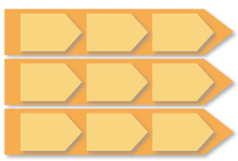
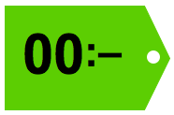
1. In a nutshell – the building blocks
Let us start by establishing a few things that you already know.
These are the building blocks for any business:
An attractive offer
The product range (also
called Product portfolio)
Offer
People
Know-how, leadership,
values, culture
Price
Business processes
Organisation, procedures,
IT solutions, efficiency
People
& culture
Business
processes
Price
Competitive prices,
“Value for money”
Creating competitive advantages
Your offer and performance along these factors will determine which customers you will attract.
Next

Slide 5
1. In a nutshell – your challenge as a team
You are a member of, for example, Alpha’s management team.
Alpha
Your company has (at least) three major competitors.
Beta
You are all fighting for the same customers in a changing market.
The customers have different needs and preferences.
This is what matters to them:
  Your OFFER (product portfolio)
  Your PEOPLE (skills & culture)
  Your PROCESSES (efficiency)
and your PRICES
Offer
Delta
Price
People
Processes
Gamma
The WINNER is…
… the company that creates the greatest short term and long term value for their main stakeholders.
Next

Slide 6
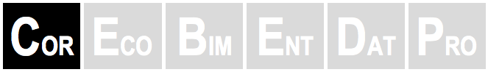
1. In a nutshell: The products
Product portfolio
About the products you can offer…
The simulated company could be anything from a typical service provider (bank, insurance, telecom, consultancy, health care) to a manufacturing company providing Value Added Services (VAS) of different kinds.
Offer
Offer
Continue
Your core offer is simply called COR.
On top of that there are five more products (or product lines) you can decide to offer. They are called:
  ECO
  BIM
  ENT
  DAT
  PRO
When you launch a new product you have to pay:
  start-up cost (one-time investment)
  running cost (yearly)
People
& culture
People
& culture
Business
processes
Business
processes
Next

Slide 7

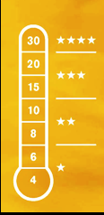
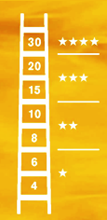
1. In a nutshell: People & Processes
Product portfolio
Product portfolio
About development
of people & processes…
It is equally important that you develop your People and Processes.
Offer
Offer
Offer
Continue
Each year you have the opportunity to invest in development of your People to go one step up the “People performance thermometer”.
Investment: 3M
Continue
People
& culture
Business
processes
People
& culture
People
& culture
Business
processes
Each year you can also invest in development of your Processes and thus go one step up the “Process performance ladder”.
Investment: 3M.
Business
processes
3M
3M
People performance thermometer
Process performance ladder
Next

Slide 8


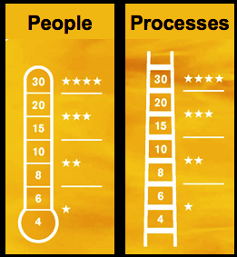
1. In a nutshell: Summary of the key elements in the simulation
Alpha
What you offer
Continue
What the customers want
Develop your product portfolio
Different customers have different product needs.
From the start you only have your core offer (COR).
COR
ECO
ENT
  There are some products that the customers demand from you.
  We call them PRIMARY needs.
BIM
ENT
BIM
ENT
BIM
ENT
COR
BIM
DAT
BIM
ENT
BIM
ENT
BIM
ENT
COR
ENT
DAT
PRO
It is up to you to decide which of the other five products you want to offer and when to launch them.
It all depends on which customers you want to attract.
BIM
ENT
BIM
ENT
BIM
ENT
  On top of that, there are products that they would like you to have.
  We call them SECONDARY needs.
COR
BIM
PRO
BIM
ENT
BIM
ENT
BIM
ENT
Continue
Continue
Develop your People and Processes
Excellent delivery
It takes many years and a lot of resources to develop the performance of your people and processes.
How you decide to prioritize depends on what you believe is most important to the customers you are targeting.
The customers also expect you to “deliver with excellence”:
They want your PEOPLE to be knowledgeable and “easy to work with”. They want your business PROCESSES to be smooth and effective.
Continue
Value for money
Last but not least: All customers want a “good price” – even if some customers are more sensitive to the price than others.
Next

Slide 9

CHAPTER 2
Customer segmentation
You can not be “all things to all customers”.
You have to make a choice.
For that reason, knowing your customers is key to success…
Many needs
S
P
In this chapter…
… we will show you how the customer knowledge is organized in the simulation:
M
Price
Value
From a blurred picture with customers all over the place…
T
A
Continue
… to a few categories of customers with similar needs and preferences
Basic needs
Next

Slide 10

2. Customer segmentation: Product needs
Segmentation: A map showing customers with similar needs and preferences as clusters.
Many needs
Here are a few examples:
First step: Different product needs.
Some customers have many needs and look for a broad range of products…
A segmentation model is a way of “mapping” customers based on their needs and preferences.
Eight customers (example).
What do they have in common?
What makes them different?
Continue
… other customers only need a few basic products.
Basic needs
Next

Slide 11
2. Customer segmentation: Sensitivity to price
Segmentation: A map showing customers with similar needs and preferences as clusters.
Many needs
Some customers tend to go for the lowest price…
… other are less price sensitive and look for the highest value.
Second step: Different views on price.
Here are a few examples:
In the simulation there is a total of 24 customers and this is how they are distributed along the two axis.
Eight customers (example).
What do they have in common?
What makes them different?
Price
Value
Basic needs
Next

Slide 12
2. Customer segmentation: A few categories
Segmentation: A map showing customers with similar needs and preferences as clusters.
Many needs
Here are a few examples:
Third step: Clustering similar customers.
Second step: Different views on price
S
P
In the simulation there is a total of 24 customers and this is how they are distributed along the two axis.
Segmentation model
In this way we have identified five groups of customer types… five customer segments.
This will be of great help when you decide which customers to go for and what you should offer.
But there is more to it…
M
Price
Value
T
A
Basic needs
Next

Slide 13
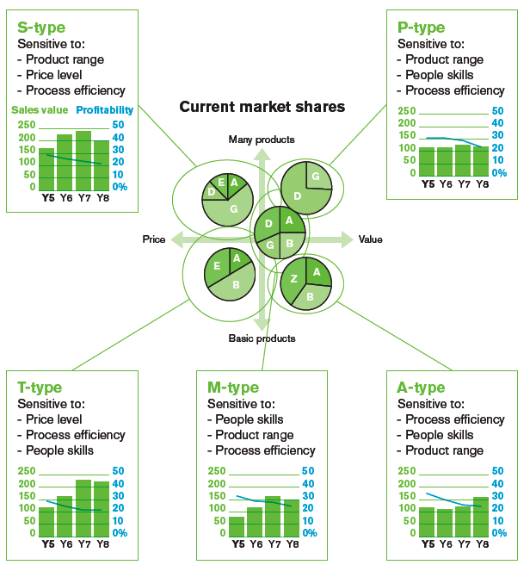
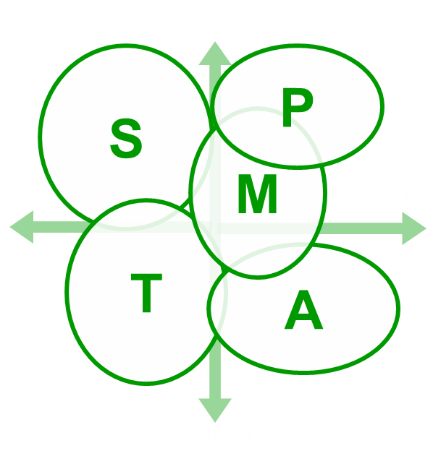
2. Customer segmentation: Similar preferences
Segmentation: A map showing customers with similar needs and preferences as clusters.
Many needs
Second step: Different views on price
Fourth step: What else do the customers in the same segment have in common?
S
P
M
Similar preferences
The relative importance of their choice criteria (preferences) is similar among customers in the same segment.
This is also of great value when you decide which customers you should target.
Price
Value
T
A
Choice criteria in order of importance.
Basic needs
Next

Slide 14


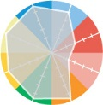


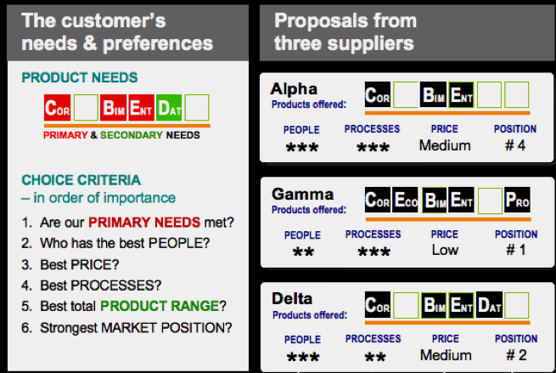

CHAPTER 3
Customer behaviour
How do customers choose between the alternatives they have?
Customers typically choose based on their needs and preferences on one hand, and on the other, how they perceive the alternatives.
Alpha
Beta
In this chapter…
… we will illustrate how the customers’ purchase behaviour works in the simulation.
Gamma
We got three proposals… Which one should we go for?
Next

Slide 15




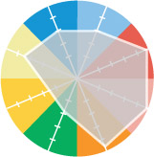
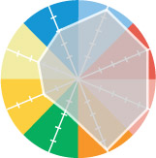
3. Customer behaviour – in general
EXAMPLE
The basic rule: A customer will choose the offer that best meet the their needs and preferences, in order of importance.
This is a common way of illustrating customers’ needs and preferences and their relative importance:
Best match of profiles
Alpha
Service scope
Basic products
Gamma
Alpha
Beta
Price
Delivery
excellence
Brand strength
Innovation
Gamma
Efficient processes
Skilled people
And different customers have different needs profiles…
Two customers with different needs and preferences…
This is how they perceive their alternatives.
Where would they choose to go?
Show me
Continue
Next we will show you how this works in the simulation.
Next

Slide 16

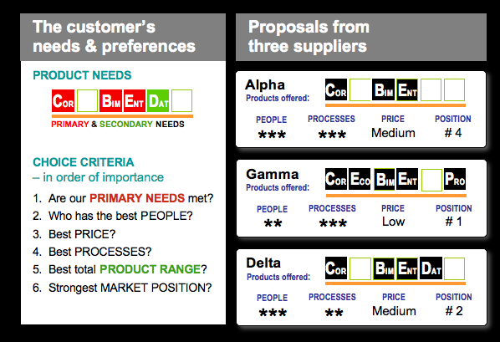
3. Customer behaviour – in the simulation
This customer submitted a request for proposal (RFP).
They got proposals from three companies, Alpha, Gamma and Delta… Who will they choose, and why?
HOW THIS CUSTOMER DECIDES:
Continue
1. Primary needs (red)
All three companies meet these needs. It is a tie.
Continue
2. People
Alpha and Delta both have three stars. Gamma has only two stars and is thus excluded.
Contimue
3. Price
The two competitors left, Alpha and Delta, have the same price. It is a tie.
Products offered
Continue
4. Processes
Alpha has better performance than Delta and wins the order.
Conclusion
Knowing your targeted customers’ needs and preferences is necessary but not sufficient…
You also need to closely watch your competitors.
Performance of
People & Processes
Price tag
Market position
Brand strength
1 = strongest
1 to 4 stars (4 = Excellent)
Next

Slide 17
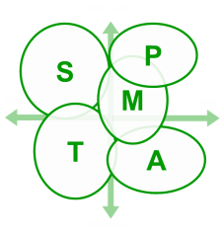
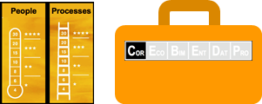

CHAPTER 4
Running the simulation
DEVELOPMENT PLAN
Your most important decisions each year:
How you should use your limited investment budget (9m)
– which depends on which customer segments you are targeting.
You have requests for proposal from several customers.
Which (maximum 3) customer orders should you pitch for?
In this chapter…
… we will give you a few examples of possible lines of reasoning behind these two important decisions.
ORDERS TO PITCH FOR
WHAT THE CUSTOMERS ASK FOR
Rfp
Rfp
Rfp
Rfp
Rfp
Rfp
Rfp
Rfp
Requests for proposal with information about:
  Primary needs
  Choice criteria, in order of importance
  Volume (capacity need) and Price range
WHAT YOU CAN OFFER
Next

Slide 18


4. Running the simulation: Development
What S customers typically look for:
  Many products
  Efficiency
  Low price
STEP 1: Decide on a DEVELOPMENT PLAN for the coming year.
Example of a possible line of reasoning:
”
Continue
We have customers in the M and T segments. Let us also go for some customers in the S segment…
Then we need more products…
Yes, and we need to invest in Processes as the S customers are sensitive to efficiency.
Continue
One step up the ladder, from GOOD to VERY GOOD (3 stars).
INVESTMENT: 3M
What about our People?
Possibly next year
– we only have 9M to invest this year.
CURRENT PROFILE
Products
OK… Let’s go for it!
Two new products INVESTMENT:
3M + 3M = 6M
Next

Slide 19

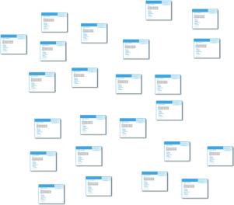
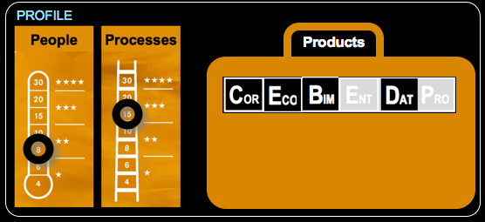
4. Running the simulation: Pitching for orders
STEP 2: Decide which ORDERS TO PITCH FOR in response to requests for proposals.
Examples of questions to discuss:
”
Continue
For which customers is there a match between their primary needs and what we offer?
WHAT THE CUSTOMERS ASK FOR
Rfp
Rfp
Rfp
Rfp
Rfp
Rfp
Rfp
Rfp
Are we strong enough on these customers’ top choice criteria?
Requests for proposal with information about:
  Primary needs
  Choice criteria, in order of importance
  Volume (capacity need) and Price range
Is the size of the order good enough – both in terms of volume and possible price level?
Which competitors are we likely to pitch against? Can we beat them?
Rfp
Rfp
Rfp
Rfp
Rfp
Rfp
Which three orders to pitch for
As some of these customers are price sensitive, do we need to offer them a low or even an extra low price?
Two proposals at LOW PRICE,
one at EXTRA LOW PRICE.
Most likely. OK… Let’s go for these three!
WHAT YOU CAN OFFER
Next

Slide 20
4. Running the simulation: Capacity
STEP 3: Decide on delivery capacity – is there a need for increase – or decrease?
Example of a discussion on the alternatives:
Capacity
“Outsourcing” as needed
”
Continue
– If we get all orders we have pitched for we need to hire a lot more people…
Need for more
… or less?
Current capacity
– True. But if we do not get any new customer, there is a lot capacity that we cannot utilize…
– That’s quite pessimistic. I suggest that we stick to the capacity we have, and, if need be…
Capacity reserved for existing customers
we could always outsource some jobs, even if it costs a bit more...
– Why not? Both recruiting and dismissing people is also quite costly.
– OK… Let us be optimistic and yet cautious!
There are two types of capacity available:
  INTERNAL CAPACITY = people on your payroll
  EXTERNAL CAPACITY = “outsourcing”
  (25% higher cost)
Next

Slide 21
4. Running the simulation: At the market place
STEP 4: Go to the MARKET PLACE and compete for the orders.
Examples of what could happen:
Alpha
Beta
Continue
Seven new customers on the market
– from LIBRA to RIGEL
LIBRA went directly to GAMMA who was uncontested.
S
S
P
P
LEO had difficulties to choose – ended up with BETA who had a stronger market position.
M
M
PULSAR had to choose between ALPHA and BETA. ALPHA won the order on better price.
T
DELTA won both LUNA and VEGA thanks to more developed business processes.
T
A
A
RIGEL is a returning customer who after a while decided to stay with ALPHA… based on loyalty.
No bids for CAPRI who had to look for solutions somewhere else.
Delta
Gamma
Next

Slide 22
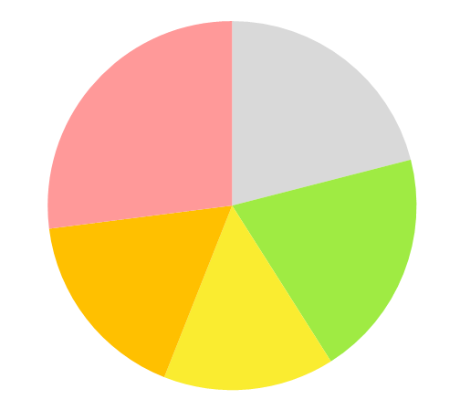
4. Running the simulation: Closing the year
STEP 5: Deliver, finalize the year and evaluate the outcome.
These are the steps in short:
DELIVER
CLOSE THE BOOKS
Capacity
Market value
Continue
Brand value
DELIVERY means that you allocate resources to the customers you serve.
CLOSE THE BOOKS to see how your profit, cash-flow and brand value have developed.
Profit
Year
Year
EVALUATE
At this point you will now have a lot of data to analyse. This includes, on top of the above:
MARKET SHARES
BRAND POSITION
A
S
P
Market data: Your standing in relation to the competition such as market share and brand position.
B
A
M
D
T
Score card: How your Key Performance Indicators (KPIs) have developed – including different aspects of profitability, customer satisfaction and efficiency,
B
A
G
D
G
This done, you are ready to study the forecast and plan for the next years…
SCORE CARD
Year
Next

Slide 23


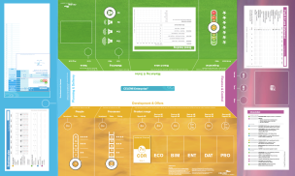
CHAPTER 5
Prepare for the real thing
In this last chapter…
… we will wrap up this short presentation by letting you ponder the two questions at the right.
What role do you want to have in your team?
What strategy would you argue for?
S
P
M
T
A
Next

Slide 24
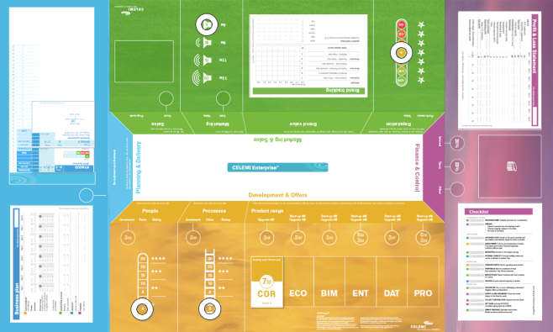
5. Prepare for the real thing
1. Which role do you want to have in your management team?
Planning & Delivery
Marketing & Sales
Manage all customer deliveries
Hire staff and contractors
Coordinate Business plan
Represent the company at the marketplace
Track Brand value
Promotion and proposals
This is the simulation board, with the main areas in different colours.
Continue
These are the team members’ roles and responsibilities.
Which role do you want to have?
  One in which you are most comfortable?
  or
  One in which you have the most to learn?
Development & Offers
Finance & Control
Manage solutions portfolio
Develop people and processes
Corporate intelligence
Control operations
Manage cash, audits, P&L
Handle deals with parent company
Next

Slide 25
5. Prepare for the real thing
2. Which strategy would you primarily argue for?
Market potential in the different customer segments
This is the five customer segments.
Choosing a strategy is mainly about which one or more customer segment you should go for.
Many needs
Continue
The relative size of the business potential in each segment is shown at the right.
S
P
SMALL
Based on this:
Which customer types would you primarily target?
What do you think your competitors will do?
What would be your “Plan B”?
LARGE
M
MEDIUM
T
Price
Value
A
LARGE
MEDIUM
Basic needs
Next

Slide 26


End

